Slide 1
Accessing the Curriculum for Diverse Learners
Embedding Learning Opportunities

Slide 2
Designing Inclusive Instruction
TIER III
Intensive Differentiation
for individual students
(5%)
TIER II
Individualized Differentiation – targeted group supports for at-risk students (15%)
TIER I
Universal Design for Learning – all students (80%)

Slide 3
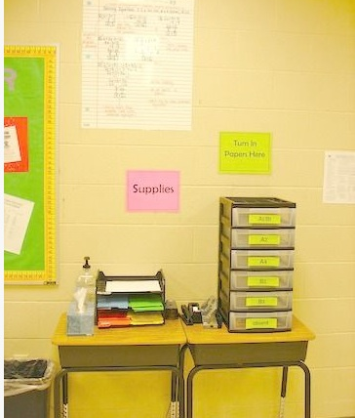
Activity: UDL with social participation
Classroom routines are opportunities for:
Differentiation
Teaching and learning
Positive interactions with peers
Complete worksheet
Discuss responses with a partner

Slide 4
Embedded Instruction
An approach used to promote
Engagement
Learning
Independence
Used within everyday (including typical classroom) activities, routines and transitions (meaningful contexts)
Planned and systematic
Multi-components: what, when and how of instruction

Slide 5
Embedded Instruction
Uses regular curricular activities, materials and routines
Targets teaching a student’s goals (general and IEP) within naturally occurring activities and routines
Maximizes motivation
Promotes acquiring a skill, becoming fluent and maintaining that skill (lots of use)
Promotes transferring learning from one situation/context to another (generalization)

Slide 6
Difference between embedded instruction and teachable moments
Embedded instruction
Planned
Teachable Moments
Spontaneous
Driven by a student’s goals
Ensures instruction occurs
Systematic monitoring
Driven by “the moment”
Taking advantage of an opportunity
Monitoring haphazard

Slide 7

Student’s Learning Objectives
Identified from:
IEP
Classroom curriculum (PLO)
Family input
Student input
Through observation and assessment
During routine classroom activities, Caleb will use 3-words phrases to ask for things or to tell people things.

Slide 8
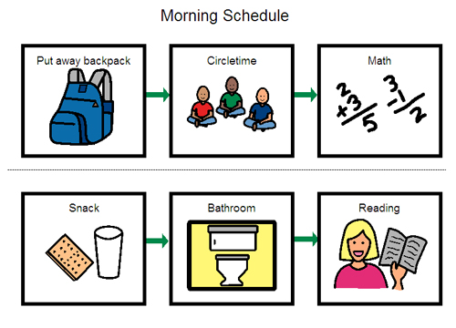
Curriculum Matrix
Supports and ensures students learn in everyday activities
Can be used with one student and several objectives
Can be used with several students
Focuses on what and when

Slide 9
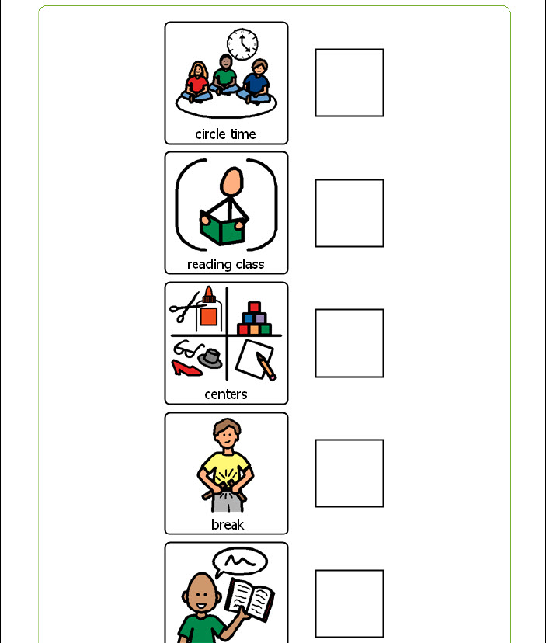
Activity: Matrix & Caleb’s Objective

Slide 10

The “how” of Instruction
What are the many concepts and practices that an EA needs to think about and do when providing instruction?

